Slide 1

Charles Xu Yale University Rising Sophomore Advisors: Ms. Stacey Martens and Mr. Bryan Gamboa

Slide 2
Epidemiological Modeling of SARS-CoV-2 Spread Under Inactivation Measures
Charles Xu CEE Summer Intern, Bryan Gamboa and Stacey Martens/San Antonio
August 4, 2020
Place proper DISTRIBUTION number here.

Slide 3
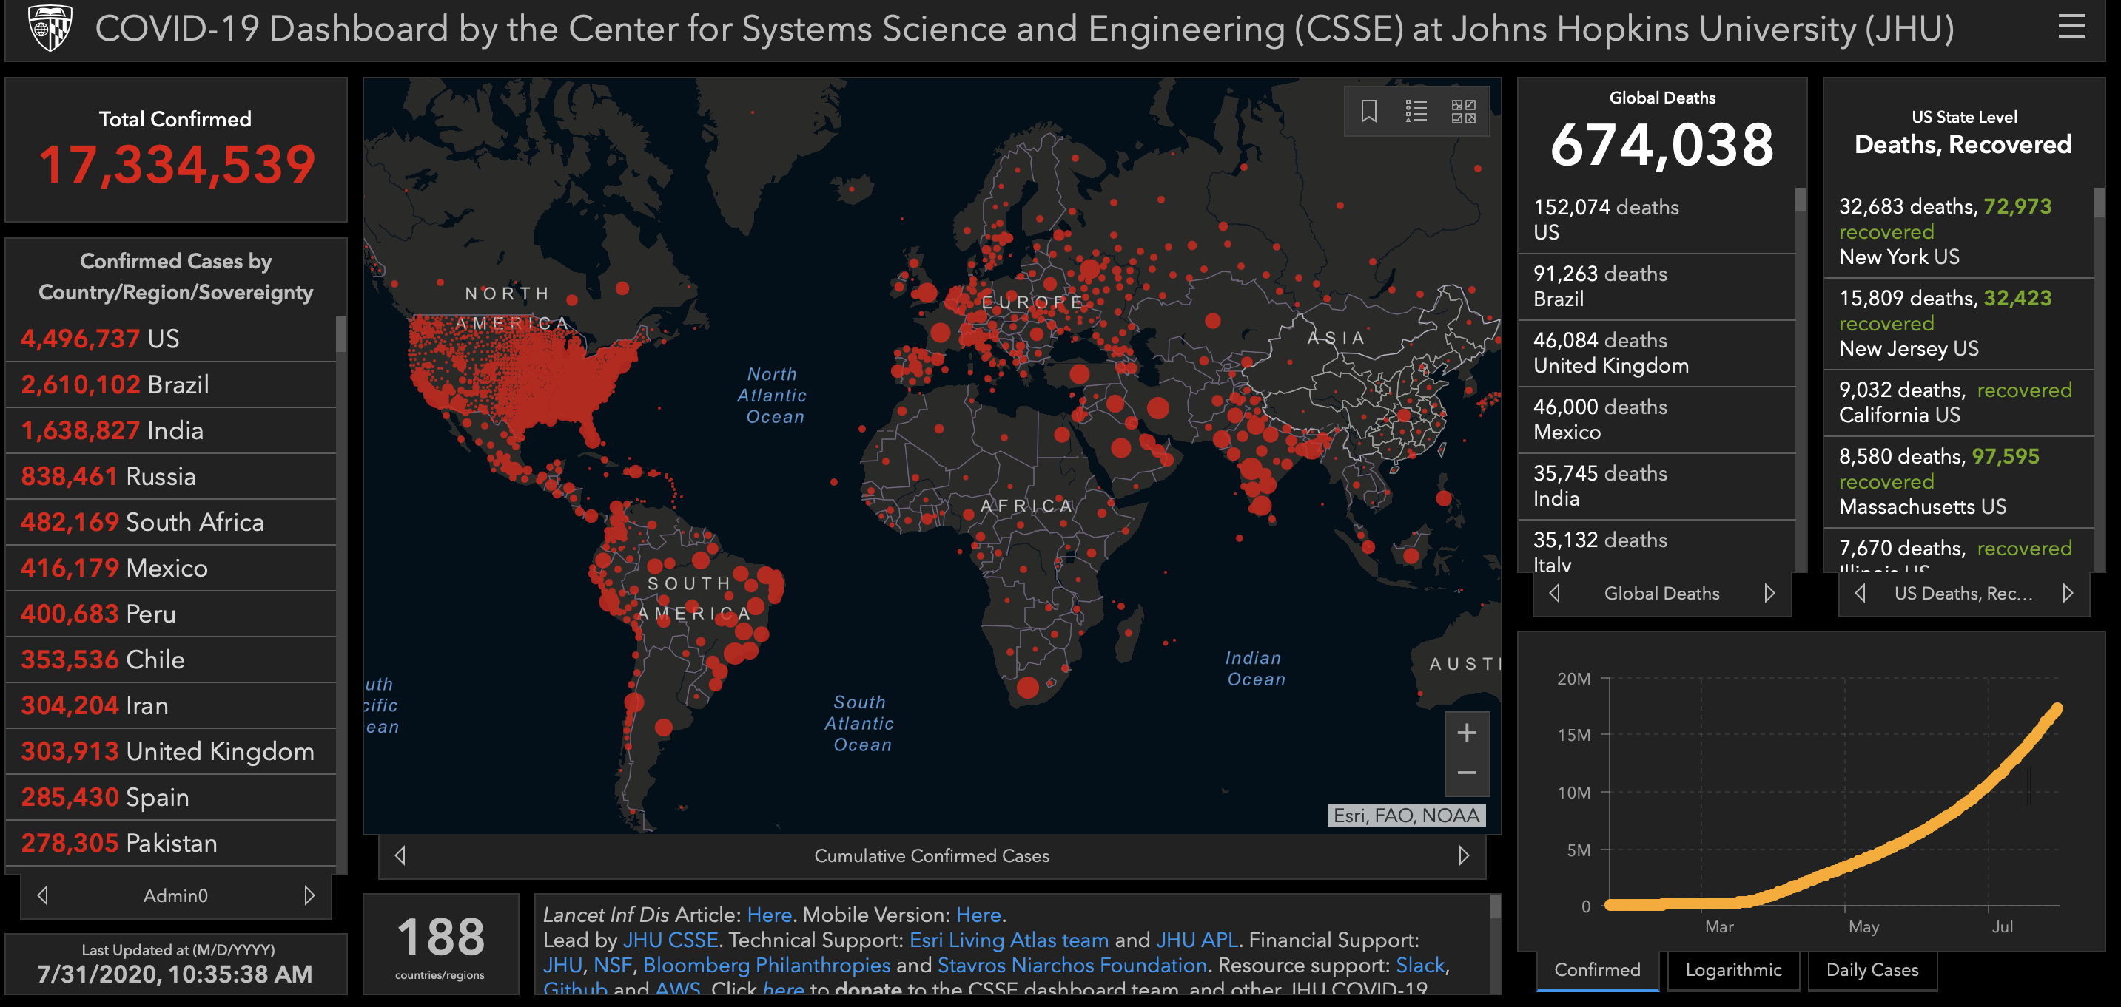
Internship Overview
Conducted research from home in MA with help from my mentor and VIDER team
Studying coronavirus inactivation using radio frequency, membrane properties, and MD simulations

Slide 4
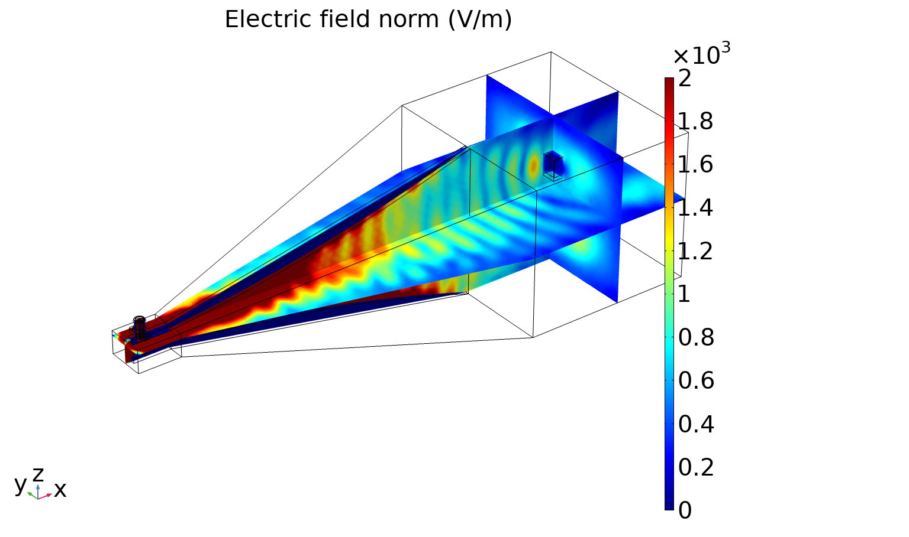
Overview
VIDER is working on direct inactivation of the coronavirus
Resonant absorption of radio frequency energy can inactivate viral particles
Likely mechanism is through a physical fracturing of the membrane
Inactivation occurs at power densities that are safe for the general public
Mathematical modeling can aid in development and deployment of inactivation technology
Provide a greater understanding of the impacts of radio frequency inactivation on COVID spread
Assess role in reducing hospitalizations and deaths
Set targets for inactivation and RF coverage

Slide 5
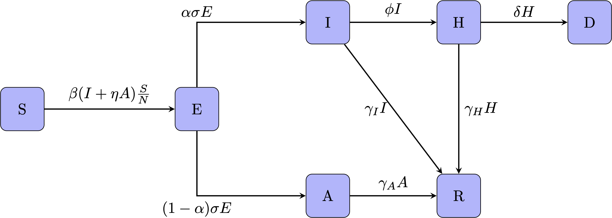
Compartmental model to simulate transmission
SEIAHRD compartmental framework (Susceptible, Exposed, Infectious, Asymptomatic Infectious, Hospitalized, Recovered, Dead)

Slide 6
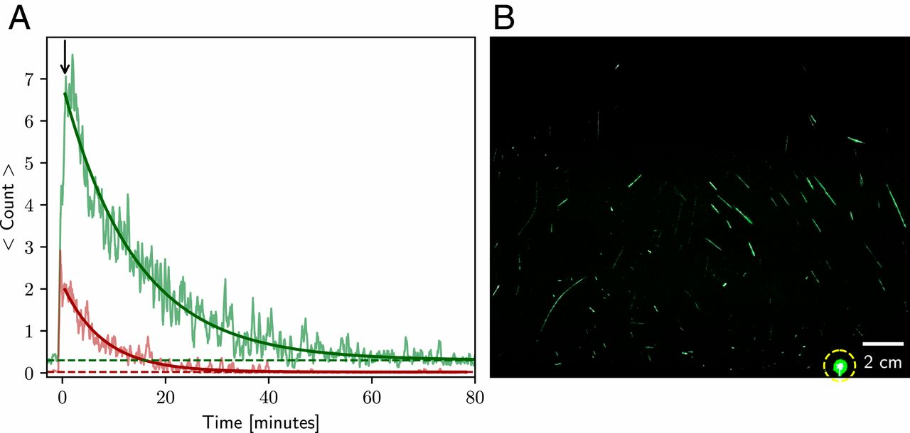
Accounting for inactivation
Efficacy depends on rate of inactivation.
Independent action hypothesis (IAH) states that each virion has an equal, nonzero probability of causing an infection
Probability of infection is directly proportional to number of airborne viral particles
Figure from Stadnytskyi et al. 2020
Total inactivation has been documented to occur in 15 minutes (Yang et al. 2015)
Assume that inactivation occurs at a linear rate (conservative estimate)
Divide interaction into two groups: Protected by inactivation technology and not protected

Slide 7
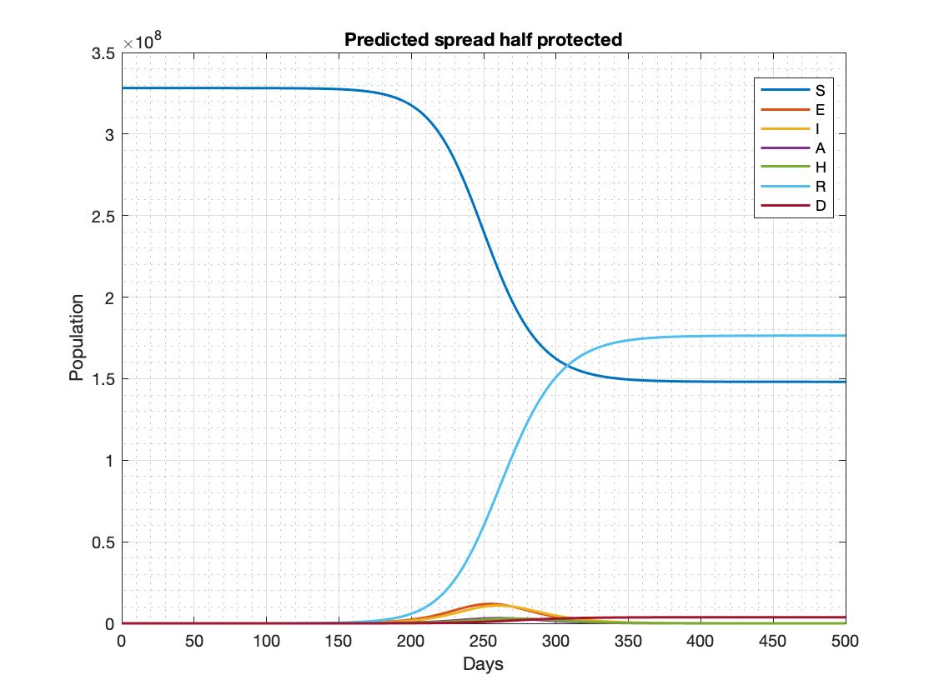
Simulation was run for 500 days
Example run of the simulation on a model population
Assumes that baseline infectious contact rate remains unchanged
As individuals become infected and recover, the number of susceptible individuals decreases
Herd immunity is observed at the end

Slide 8
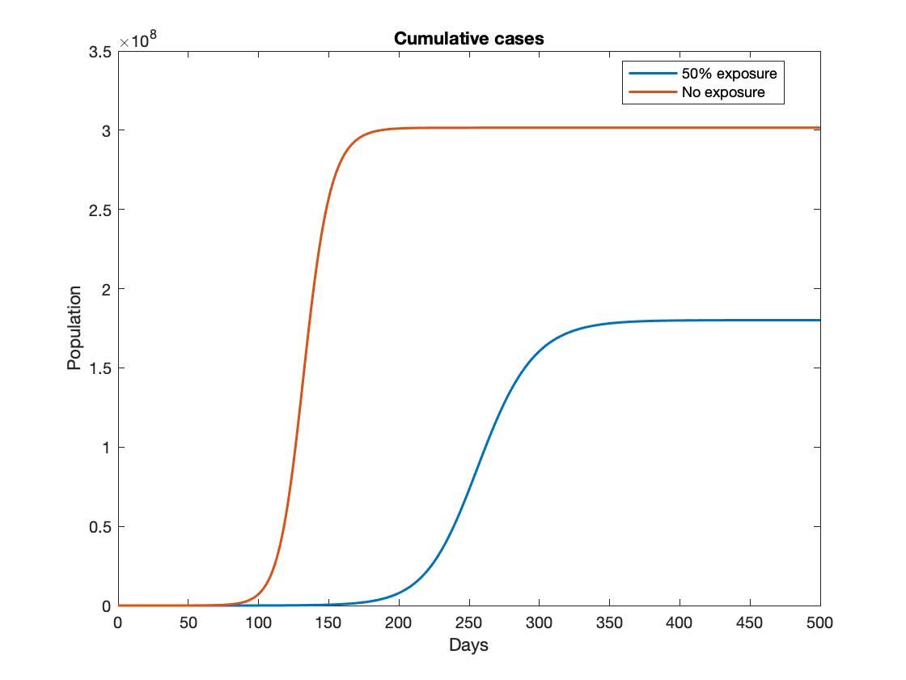
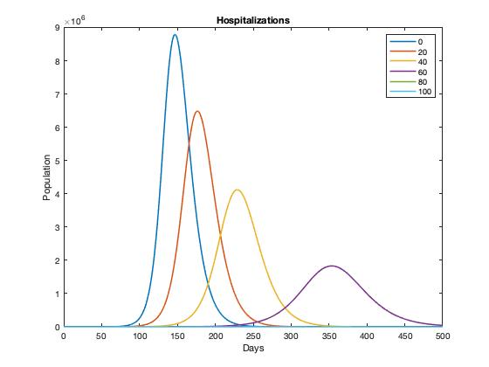
Increasing coverage decreases deaths and hospitalizations
Decrease in peak number of cumulative cases
Occurs more gradually
Decrease in peak hospitalizations
Inactivation technology contributes to the flattening of hospitalization curves

Slide 9
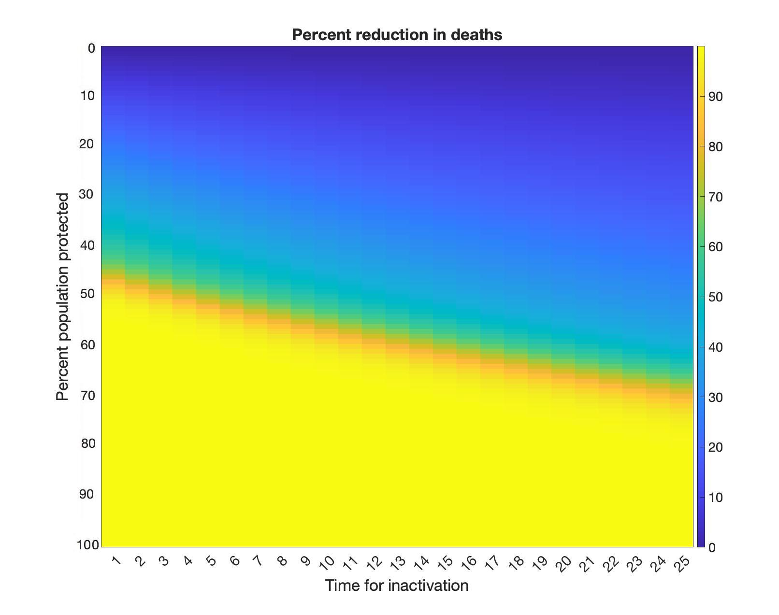
Outcomes are dependent upon coverage and time for inactivation
It is possible to stop the spread of the pandemic with inactivation technology as a standalone strategy with sufficiently fast inactivation and widespread coverage

Slide 10
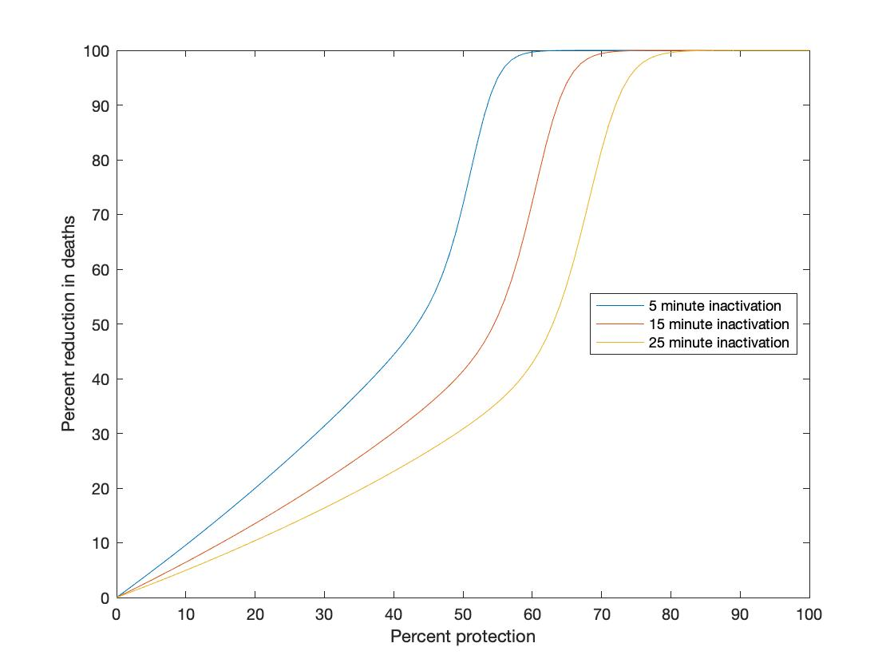
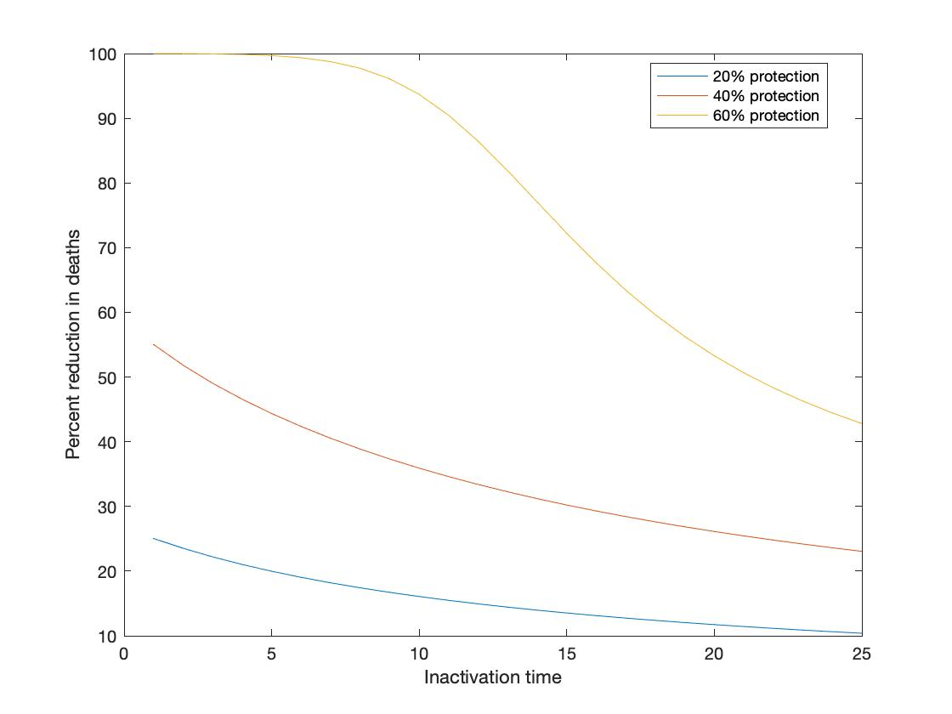
Responses to increasing coverage and rate of inactivation are non-linear
Benefits to the population accelerate as coverage increases. The pandemic may be eliminated with 50-70% coverage, depending on the inactivation time
Reduction in death accelerates as inactivation time approaches zero

Slide 11
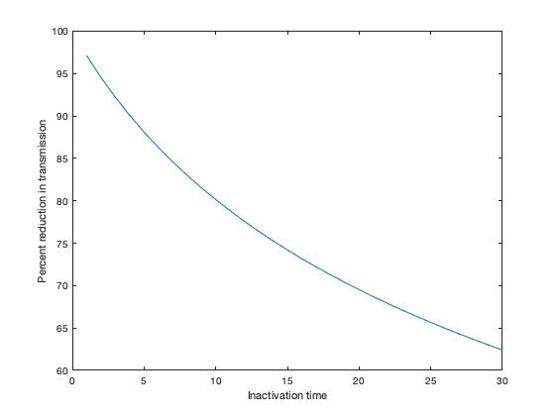
Inactivation technology is promising for halting viral spread
Like other non-pharmaceutical interventions (NPI), inactivation technology is best used in tandem with measures such as social distancing, masking and contact reduction
Due to non-linear responses, NPIs work synergistically
Although widespread coverage maybe be difficult to achieve, inactivation technology could be applied to essential operations
Assuming total coverage, safety in these locations will depend on rate of inactivation

Slide 12
Conclusions
Inactivation technology can have a significant impact on the spread of the pandemic, and these benefits grow in response to increases in inactivation rate and coverage
While widespread coverage may be difficult to achieve, efficient inactivation can help essential operations stay open
Next steps
Improvements to the model will enable direct fitting to the 2019 SARS-CoV-2 outbreak
Incorporating contact network structures and agent-based models can help determine sites for the most efficient deployment of inactivation technology

Slide 13
Acknowledgements
My mentors Mr. Bryan Gamboa and Ms. Stacey Martens
Dr. Robert Thomas and the whole VIDER team
RHD
CEE

